Slide 1
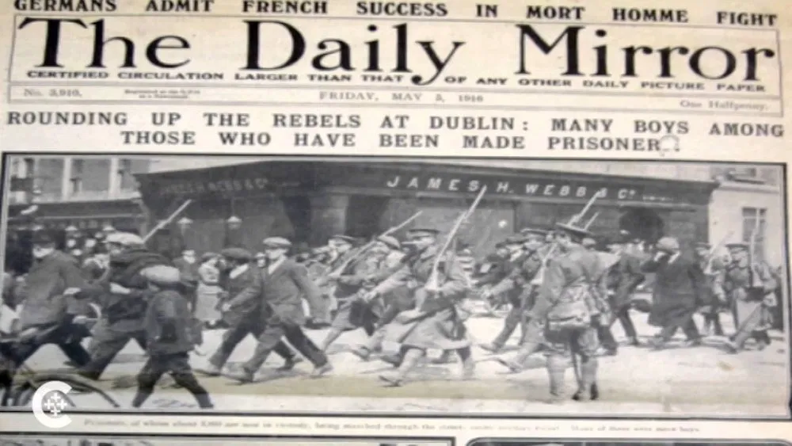
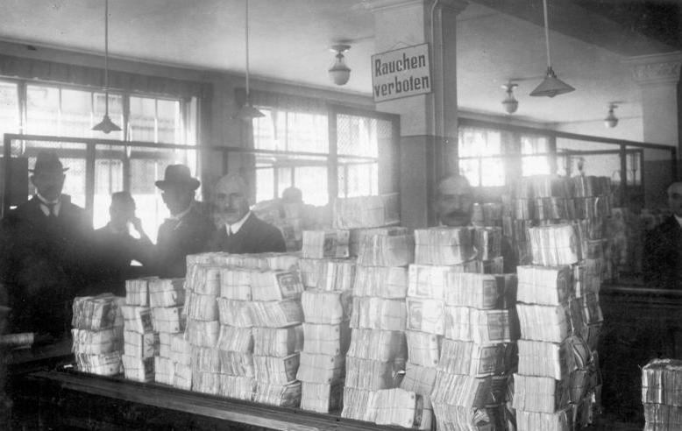
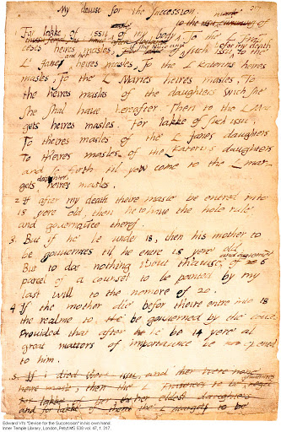
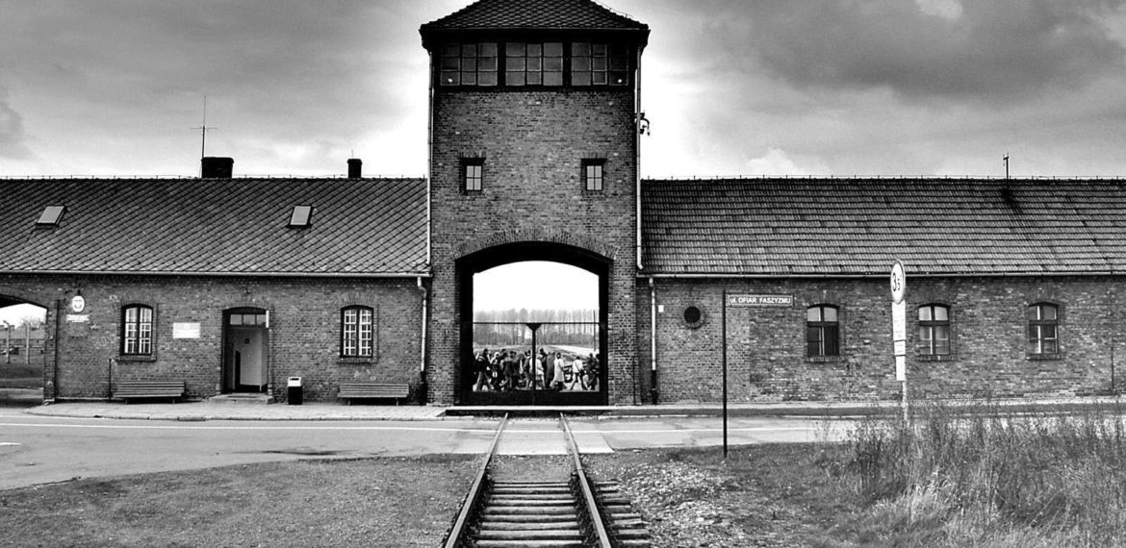
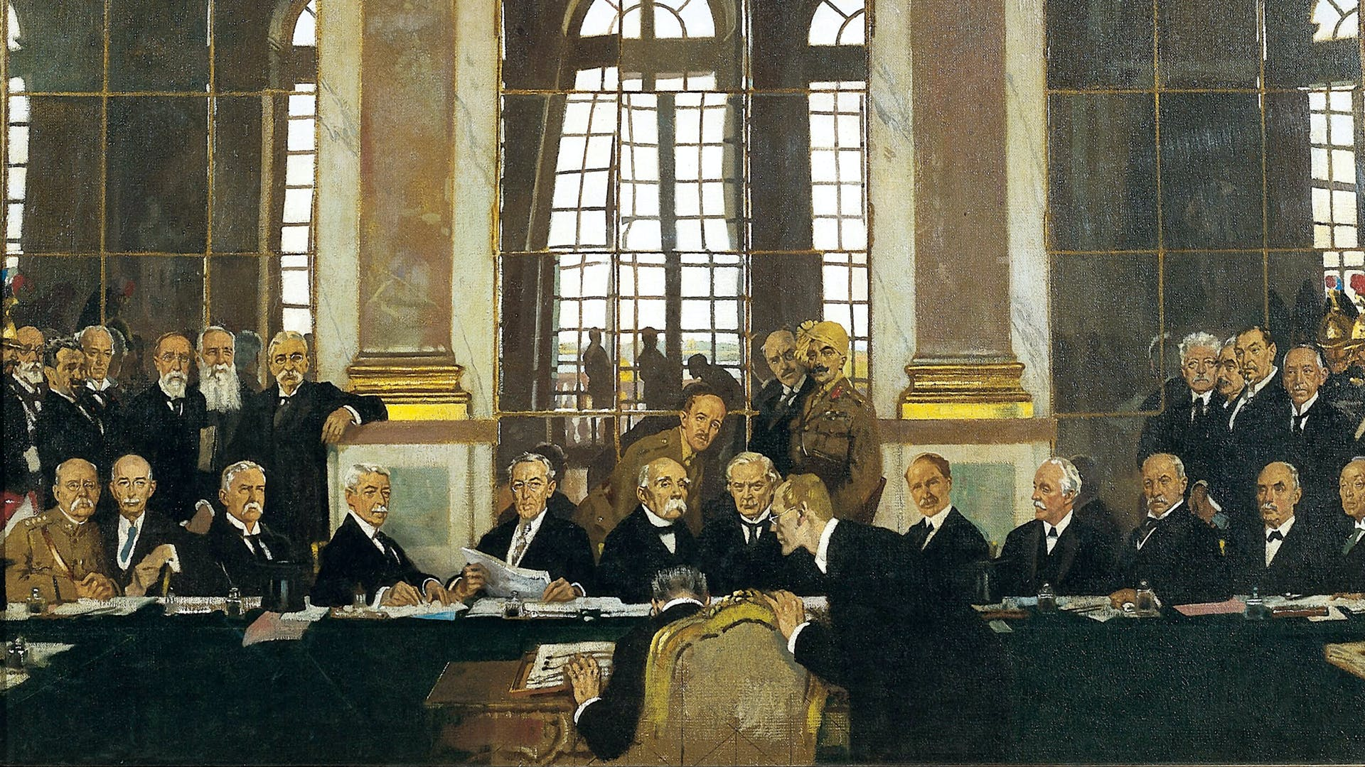
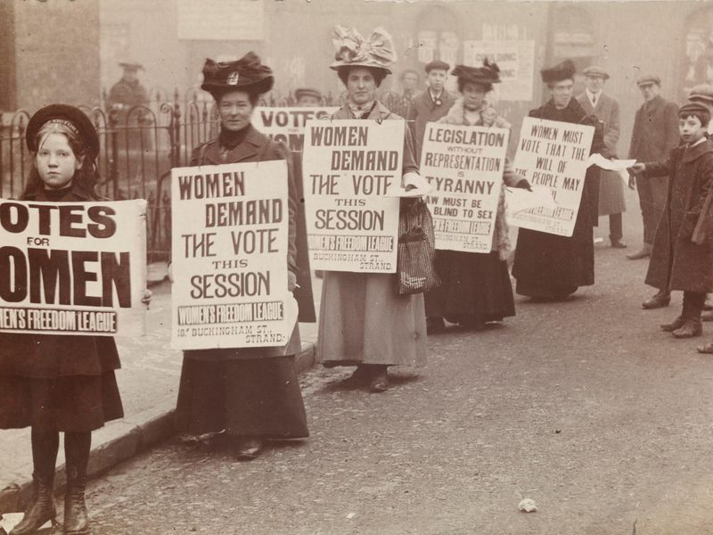
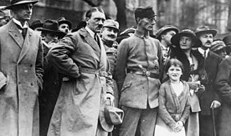
A-Level History Taster Session
Starter: What is History? Think, Pair, Share.

Slide 2
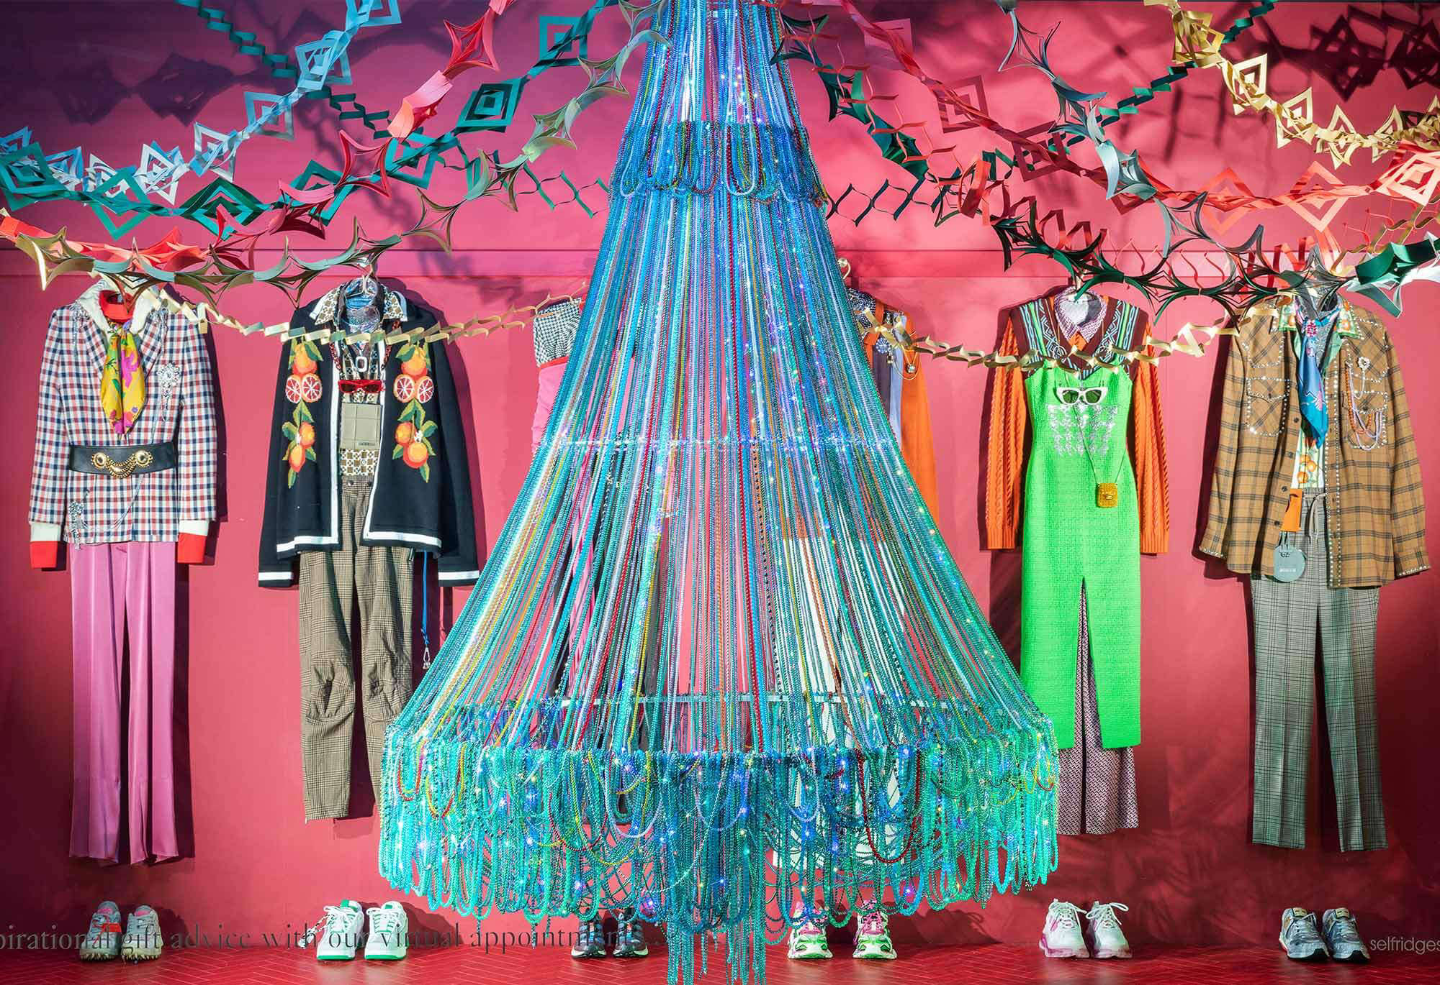

Slide 3
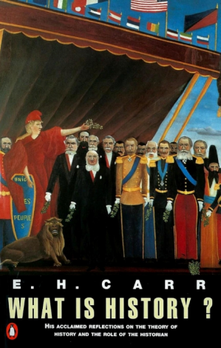
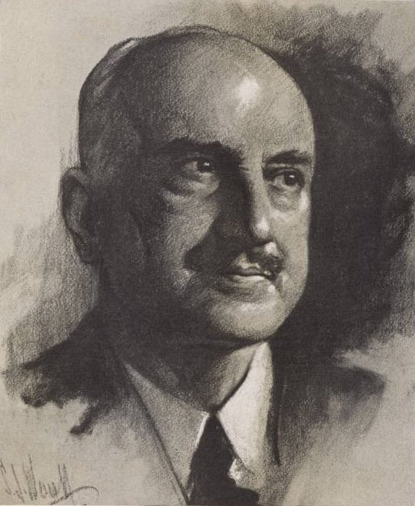
Why are we here?! What is History and what do I need to know to thrive at A-Level?
History is a pack of lies about events that never happened told by people who weren’t there.
Historian George Santayana
Learning Objectives:
To consider what Historians do and how History is constructed.
To share some top tips to help you thrive at A-Level.

Slide 4
A-Level History Taster Session
Big Picture: Why History? Why are we here?

Slide 5
A-Level History Taster Session
What will we be doing in the next 2 years?
Unit 1 Challenge and transformation: Britain, c1851–1964
Exam 2017 = 2 hours and 30 minutes and 40% of grade.
Unit 2 Democracy and Nazism: Germany, 1918–1945
Exam 2017 = 2 hours and 30 minutes and 40% of grade.
Unit 3 Coursework 20% of grade

Slide 6
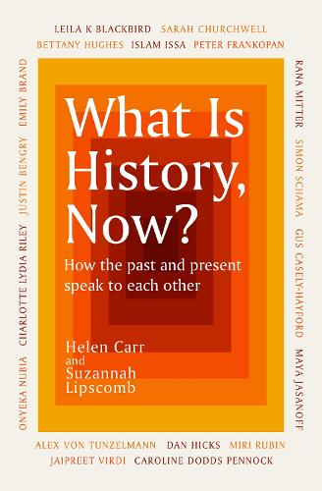
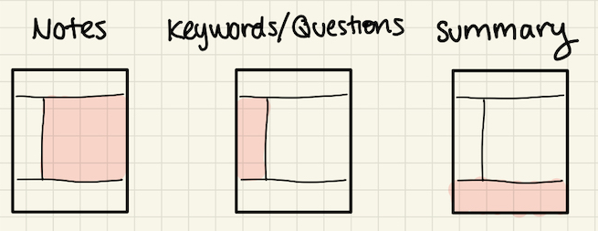
A-Level History Taster Session
What is History Now? is a collection addressing the burning issues of how we interpret history today. What stories are told, and by whom, who should be celebrated, and what rewritten, are questions that have been asked recently not just within the history world, but by all of us.
What is History, Now? covers topics such as the history of racism and anti-racism, LGBTQ+ history, the history of faith, the history of disability, environmental history, escaping imperial nostalgia, hearing women's voices and 'rewriting' the past. Today we will see if we can understand sections of this book to make clearer sense of our job as Historians!
Read the passage, highlight key information and make notes like a Historian! Then use this key information to answer the following questions.
Why has History been such an area of debate recently?
Can and should History be rewritten?
What is History? What do Historians do?
What is a historical fact?
What is an interpretation?
How has the recording of History changed since the 19th Century?
What challenges do modern-day Historians face?

Slide 7
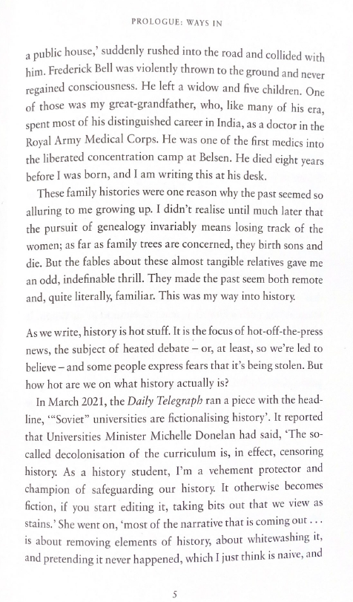
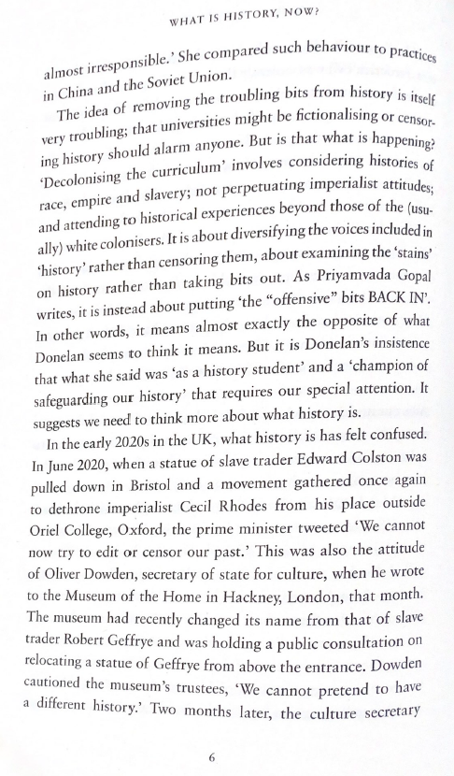

Slide 13
A-Level History Taster Session
Review: What is History? Think, Pair, Share.

Slide 14
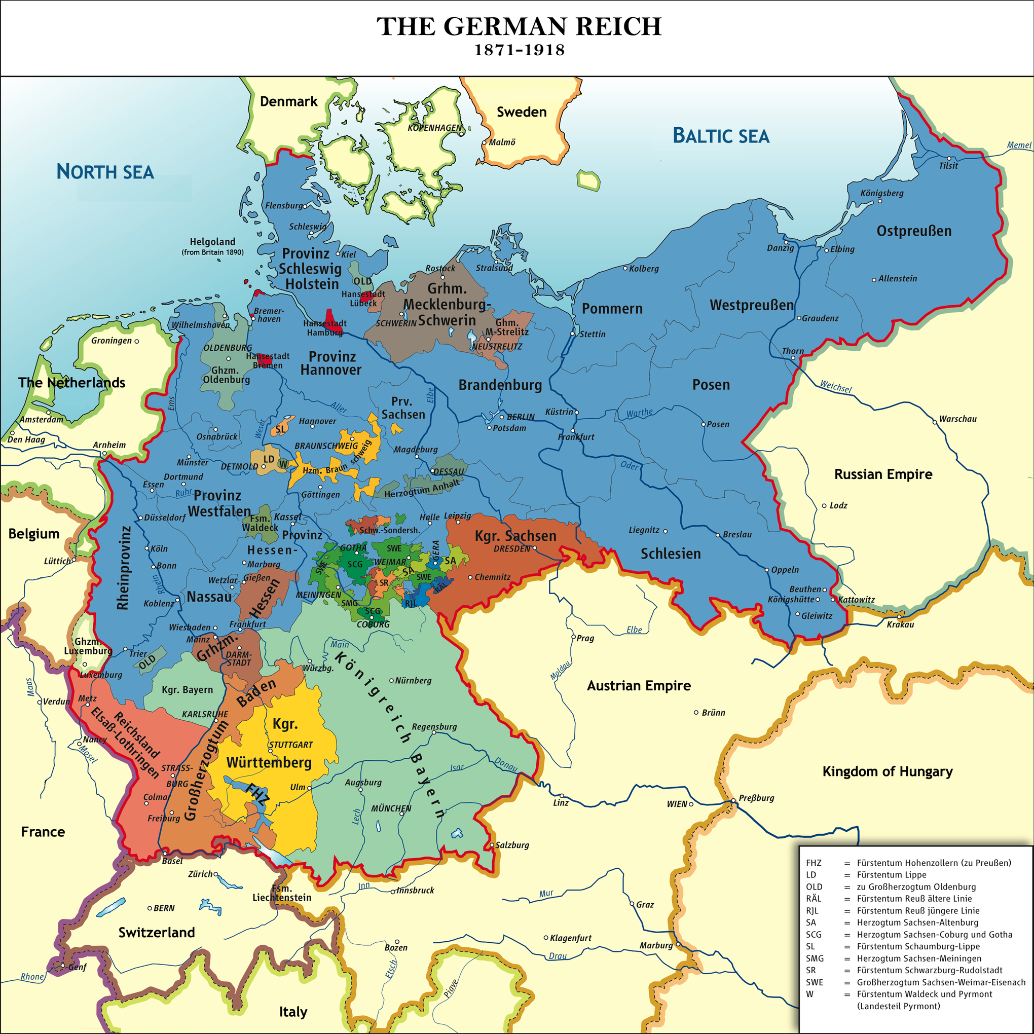
What was Germany like before World War I?
Government
Recent History
Wealth
Population
Problems
Rivals and Allies

Slide 15
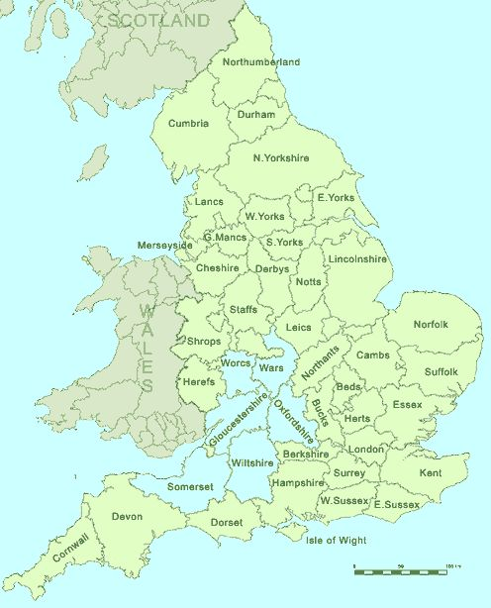
What was the UK like in the 19th Century?
Government
Recent History
Wealth
Population
Problems
Rivals and Allies

Slide 16

A-Level History Taster Session
How to hit the ground running in September?
Complete your transition tasks!
Get reading, listening and watching to enhance your studies!
Be organised from day 1!
Throw yourself into your studies. Enjoy every minute!
Any questions?

