Slide 1

Product Design
A-Level
Transition Pack

Slide 2
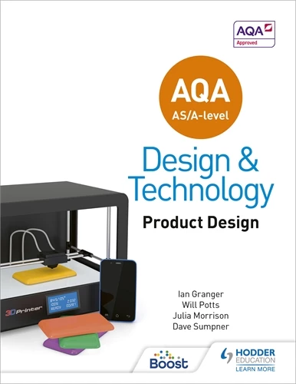
COURSE INTRODUCTION
2
Throughout the course you will look at the physical and working
properties of a wide range of materials and components so that you can develop an understanding of why they are used in different applications. You will also consider their manufacture, use and life span of a product. Through manufacturing and design you will identify safe working practices and understand the various processes that can apply to a product. You will then apply this knowledge to produce a physical prototype that communicates your research, design, practical work and
evaluation to others.
Essential summer reading
AQA AS/A-Level Design and Technology: Product Design
Will Potts, Julia Morrison, Ian Granger, Dave Sumpner.
ISBN: 9781510414082

Slide 3
Assessment overview of the NEA
You will produce a substantial design, make and evaluate project which consists of a portfolio and a prototype. The assessment will be carried out under controlled conditions, as specified within the qualification's specification.
The final prototype must be produced under immediate guidance or supervision.
The portfolio will contain approximately 40 sides of A3 paper (or electronic equivalent) There are five parts to the assessment:
Section A: Overall 20 marks (Identifying and investigating design possibilities)
Identification and investigation of a design possibility, investigation of client/end user needs, wants and values, research conclusions and practical primary research .
Section B: Overall 10 marks (Design Brief & Specification )
Identification and evidence of a clearly written Brief and Specification linking to
previous research.
Section C: Overall 25 marks (Development of Design Proposals)
Design ideas, development of design idea, final design solution, review of
development and final design and communication of design ideas.
Section D: Overall 25 marks (Developing design Prototypes)
Design, manufacture and realisation of a final prototype, including tools and
equipment and quality and accuracy.
Section E: Overall 20 marks (Analysing and Evaluating)
Testing and evaluation.
3

Slide 4
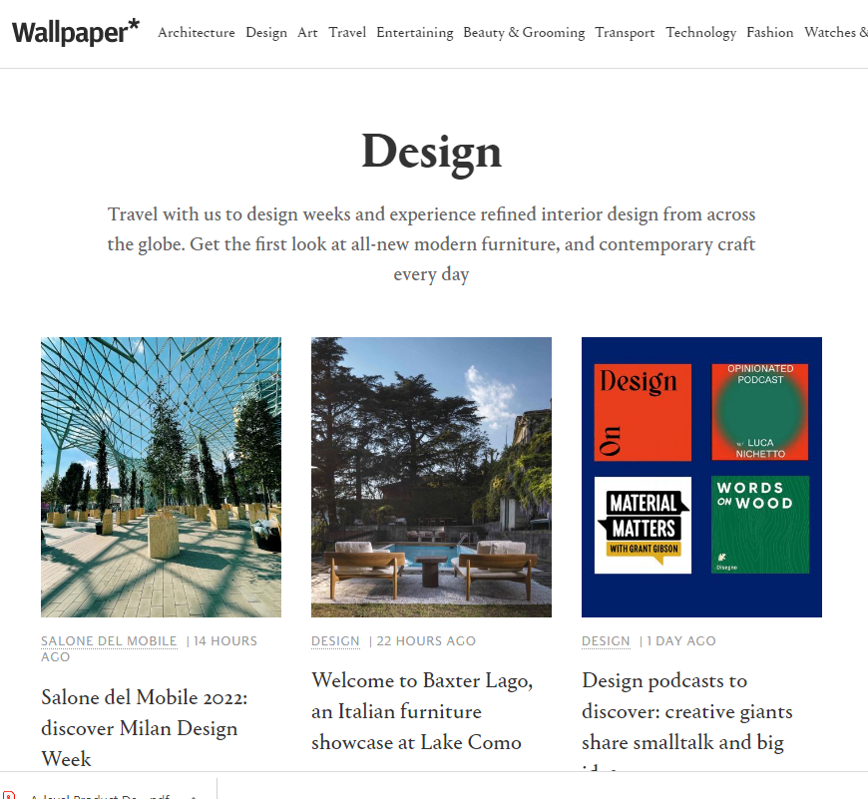
4
A Level Product Design
Useful Resources
App, Magazine and website Website: https://www.wallpaper.com/ |  | Wallpaper Case Studies - Wallpaper* magazine is the world's number one global design publication, championing the best in art, architecture, interiors, fashion and contemporary lifestyle. This is an awesome tool that enables you to quickly pick a topic and flick through many a creative design with instant access to information about the design and the designer. Quick inspiration tool!
website https://designmuseum.org/ |  | The Design Museum Collection - Presents remarkable objects from London’s Design Museum; these key pieces from the collection are explored through film, audio, text and photographs. Search options include: time, material, colour, location, manufacturer and designer. Classic pieces include: the Anglepoise lamp, the Dyson vacuum.
Website https://www.dezeen.com |  | Dezeen - The world's most influential architecture, interiors and design magazine, packed full of video’s and interviews with designers who deal with current issues. This helps with listening, reading and evaluating relevant and current product design.

Slide 5
5
Website https://mocoloco.com/ |  | MoCoLoco - is a web magazine dedicated to everything related to modern contemporary design and architecture.
Website: https://www.technologystudent.com |  | Technology Student A website with lots of free specific DT technical information.
Product Design App (cost £0.99) |  | The application includes information and revision quizzes for Product Design as well as general guidance for coursework and controlled assessment tasks.
Design Week https://www.designweek.co.uk |  | A weekly web-magazine on all things design. Has some great current case-studies.

Slide 6

Summer Learning Project
6
Please select one of the following designers and complete a mini research project over the summer holidays.
You may choose to present your work in whatever media/materials you choose. This could be PowerPoint, Card, Paper, Collage, Video, 3D Models or anything else you think would be appropriate.
You will present your project when we return in September to the class so be ready!!!

Slide 7
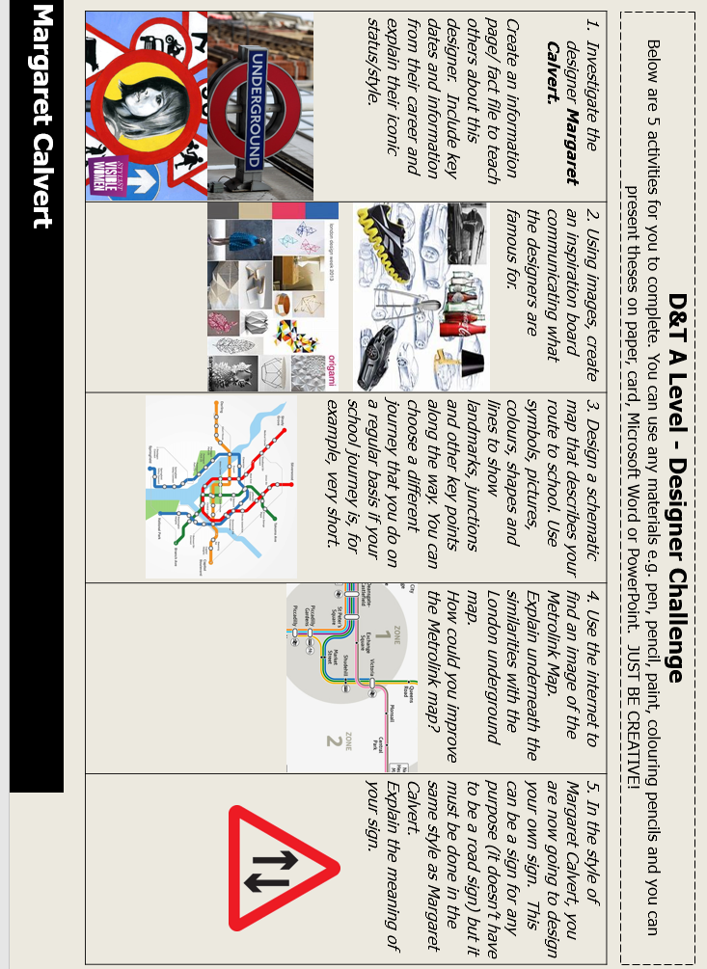
7

Slide 8
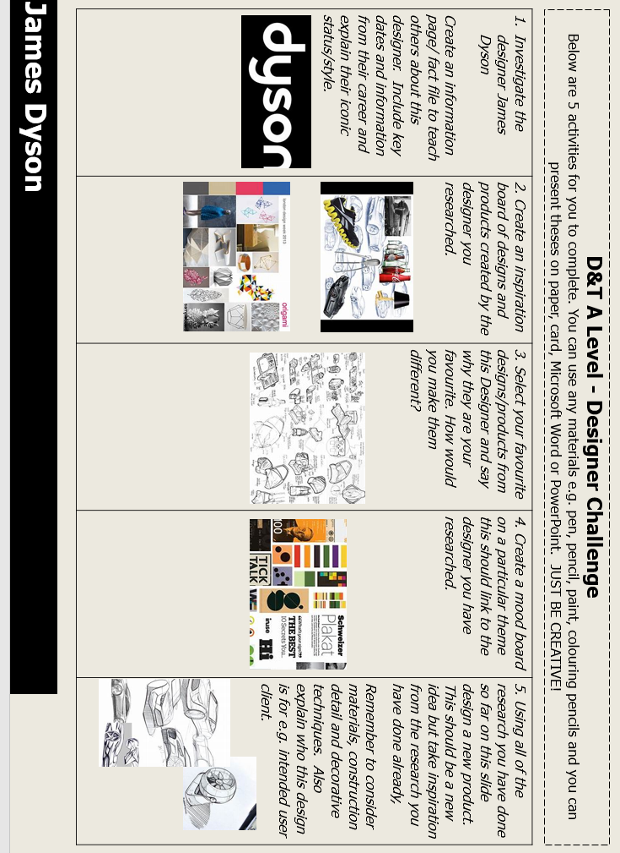
8

Slide 9
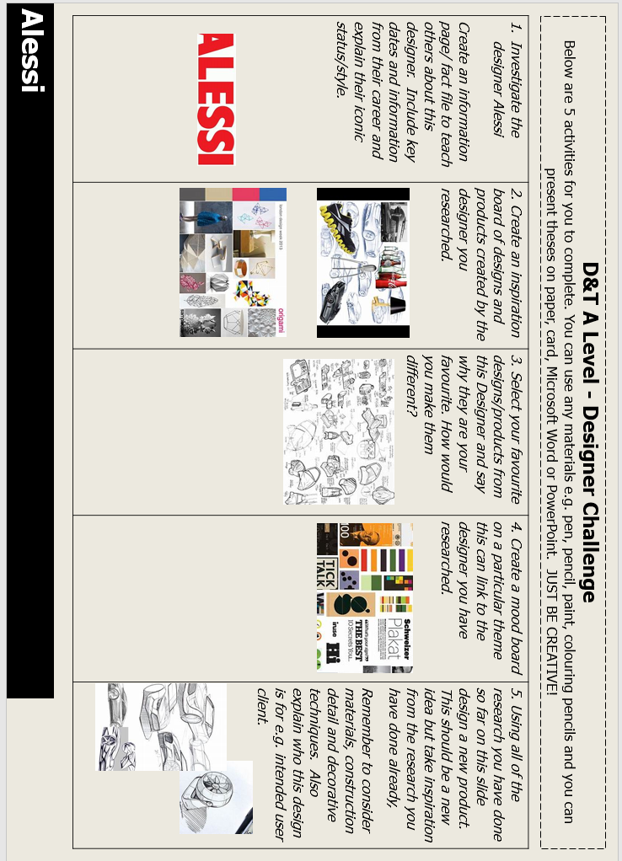
9

Slide 10
10
NOTES
________________________________________________________________________________________________________________________________________________________________________________________________________________________________________________________________________________________________________________________________________________________________________________________________________________________________________________________________________________________________________________________________________________________________________________________________________________________________________________________________________________________________________________________________________________________________________________________________________________________________________________________________________________________________________________________________________________________________________________________________________________________________________________________________________________________________________________________________________________________________________________________________________________________________________________________________________________________________________________________________________________________________________________________________

